Slide 1
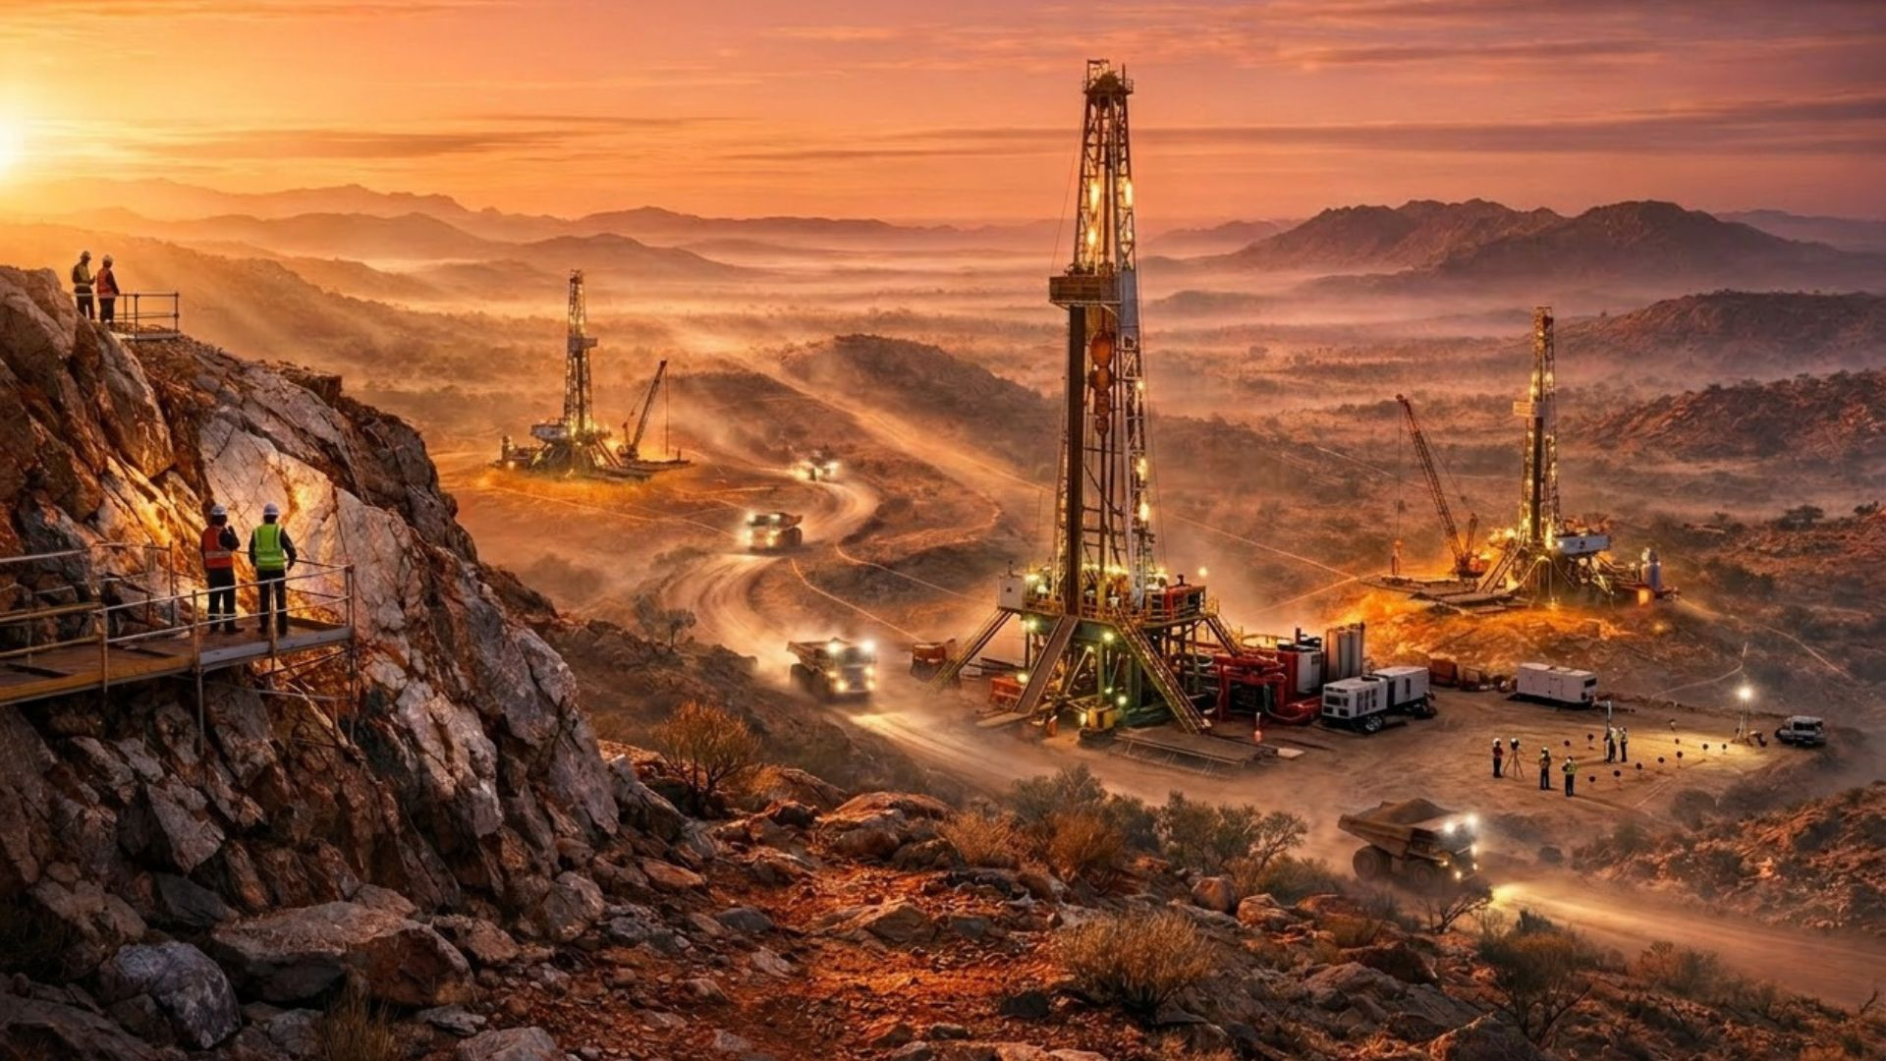


TERRAPULSE × GOLD FIELDS GHANA / 2026
01 / 12
VOL. 01 / 2026
TECHNICAL BRIEFING
A TECHNICAL BRIEFING FOR SENIOR GEOLOGISTS
Every layer of evidence, one ranked list of targets, and the paper trail to defend it.
TerraPulse takes an exploration project's data — yours and the world's public record — and returns ranked drill targets, each carrying the evidence that produced it and the full lineage needed to stand behind it.
32
FEATURES ACROSS
7 GROUPS
12
INTEGRATED
DATA SOURCES
5
STAGE PIPELINE, PROVENANCE
WRITTEN AT EVERY STAGE
BIRIMIAN-GROUND TRUTH — ASHANTI / SEFWI BELTS
AUG 2026 · ACCRA
Notes:
- Open the room: this deck is for senior geologists who own the rig decision on a Ghana licence.
- Name the question we answer: where does the rig go — and can you defend it?
- Set the Birimian context: Ashanti and Sefwi greenstone belts, Ghana licensing round 2026.
- Three stat chips preview the architecture — 32 features, 12 sources, 5-stage pipeline with provenance.
- Pace the room slowly; the next slide names the three frictions every senior geologist will recognise.

Slide 2
TERRAPULSE × GOLD FIELDS GHANA / 2026
02 / 12
WHY THIS EXISTS
The problem, as exploration teams actually experience it.
Three frictions every senior geologist on a Ghana licence recognises. None of them are about the geology — they are about the data, the reasoning, and the rework. TerraPulse is built against these three.
PROBLEM 01
01
PROBLEM 02
02
PROBLEM 03
03
The data doesn't meet.
The reasoning doesn't survive.
The work doesn't re-run.
Magnetics in one format, soil geochem in another, assay certificates as PDFs, imagery and geology somewhere else entirely. Getting them onto one grid is senior GIS work measured in weeks — not the analysis, just the assembly.
A target is a judgement made by an experienced geologist looking at several screens. When they leave, or the board asks why, the reasoning is gone — only the conclusion remains. A polygon on a map with no chain of evidence behind it.
New assays land and the integration starts again from scratch. The last analysis was a one-off deliverable, not something you can point at fresh data and press a button on. The work is dead the day it ships.
01
02
03
DATA INTEGRATION
REASONING LOSS
NO REPRODUCIBILITY
PROBLEM-FRAMING — THREE FRICTIONS
02 / 12
Notes:
- Invite the room to recognise these three frictions — they are not abstractions, they are Tuesday morning.
- Pause on "weeks of GIS work" — that is the price of admission, not the analysis.
- Problem 02 is the tenure problem: when the senior geologist leaves, the reasoning leaves with them.
- Problem 03 is why most prospectivity work dies the day it ships — it cannot be re-run on fresh data.
- Tee up the three claims that follow: assembly is automatic, the ranking explains itself, the work is defensible.

Slide 3
TERRAPULSE × GOLD FIELDS GHANA / 2026
03 / 12
CLAIM 01 / 03
Assembly is automatic.
THE PROBLEM
THE POINT
Weeks of GIS assembly before a single number.
Upload what you hold. The platform fetches the rest to your boundary.
On a typical Ashanti or Sefwi licence, getting magnetics, soil geochem, assay PDFs, imagery and the geological backdrop onto one grid is senior GIS work measured in weeks. It is not the analysis — it is the price of admission to the analysis. And it has to be redone every time a new dataset arrives.
Sentinel-2
Copernicus DEM
Iron oxide, clay/hydroxyl, vegetation indices
Terrain, slope, drainage, access
NOAA EMAG2
Macrostrat
LATENCY: WEEKS · RE-RUN: MANUAL
Regional magnetic anomaly, basement context
Lithology, age, structural units
OneGeology / BRGM
USGS MRDS
Geological map interpretation backdrop
Known deposits, occurrences, claim verification
WDPA
OpenStreetMap
Protected-area exclusion constraint
Road network, settlements, logistics
Your boundary polygon scopes every fetch. What took weeks of GIS assembly is now a boundary and a wait — your survey data and the world's public record on the same grid.
THE IMPACT
What took weeks is a polygon and a wait. The geologist starts from the evidence grid, not from the inbox.
CLAIM 01 — ASSEMBLY IS AUTOMATIC
03 / 12
Notes:
- Land the "weeks → wait" line — this is the slide's centre of gravity.
- Frame the Birimian greenstone context: Ashanti and Sefwi belts, multiple licences, repeated assembly cost.
- All eight public sources are licensed for commercial use — no rights friction.
- Your boundary polygon scopes every fetch; nothing is pulled you did not ask for.
- The next claim (02) explains why the ranking that follows is defensible.

Slide 4
TERRAPULSE × GOLD FIELDS GHANA / 2026
04 / 12
CLAIM 02 / 03
The ranking explains itself.
THE PROBLEM
THE POINT
A heatmap is a judgement you have to interpret.
Every target carries per-target evidence attribution.
Conventional prospectivity output is a colour ramp over a grid. A senior geologist reads it with their own mental model of what drives the score — structural intersection, magnetic low, gold pathfinder — but the map cannot tell them which layer pushed any given cell up. When the board asks why a target is a target, the answer is "it looks red."
TARGET 03 · RANK 3 / 17 · SCORE 78.4 / 100
PROVENANCE · ON
COORD 6°24'12"N 1°58'40"W · UTM 30N 658420E 713280N
DEPTH
Depth to source: ~120 m
EVIDENCE CONTRIBUTION
Δ SCORE
OUTPUT: COLOUR RAMP · AUDITABILITY: NONE
+24.1
Gold geochemistry (95th pct)
Magnetic low / gradient
+18.6
Iron-oxide alteration
+14.3
+9.8
Clay/hydroxyl alteration
+7.4
Deposit proximity (USGS)
+4.2
Road distance (access)
Not a heat map you interpret — a ranked list that tells you what it was reasoning from, with a depth-to-source estimate attached.
CLAIM 02 — THE RANKING EXPLAINS ITSELF
04 / 12
THE IMPACT
A geologist can agree or disagree with a specific number — not with a colour.
Notes:
- Emphasise "agree or disagree with a number" — this is the slide's emotional pivot.
- This is where a senior geologist will lean in and start checking the evidence rows.
- Walk one row live: e.g. "Gold geochemistry +24.1 — that's the 95th percentile of soil pathfinders."
- Depth-to-source is an estimate, not a promise — be transparent about that in Q&A.
- Tee up Claim 03 (defensibility): the same numbers become the audit trail when the board asks.

Slide 5
TERRAPULSE × GOLD FIELDS GHANA / 2026
05 / 12
CLAIM 03 / 03
The output is defensible.
THE PROBLEM
THE POINT
The board, the regulator, the QP — they all ask the same question.
Every layer records its source, processing and parameters.
NI 43-101, JORC, the Minerals Commission of Ghana — none of them accept a target on faith. “Show your working” is the request, and it arrives at the worst moment: months after the analysis was done, by a different geologist, on data that has since changed. Without lineage attached to the target, the answer is a reconstruction project.
01
Source file + checksum
SHA-256 checksum recorded on arrival, source URL or upload logged per layer.
02
Processing steps
Parse → reproject → krige to 50 m → reduce to pole → depth estimation. Every parameter saved.
03
Algorithm version
Deposit model version pinned to the target. Re-runs use the version that produced the original, not the latest.
04
QP annotation
Notes, review status, reviewer name and date attached per target — and carried into every export (PDF, shapefile, KML, CSV).
Built for the moment someone asks you to show your working.
THE IMPACT
REPORTS CITE WHAT THEY DREW ON, AND ARE VERSIONED RATHER THAN OVERWRITTEN. SECTIONS MOVE DRAFT → REVIEW → FINAL.
CLAIM 03 — THE OUTPUT IS DEFENSIBLE
05 / 12
Notes:
- Name the standards explicitly: NI 43-101, JORC, and the Minerals Commission of Ghana — the deck’s regulatory hook.
- The QP annotation (notes, review status, reviewer, date) persists into every export — PDF, shapefile, KML, CSV.
- Lineage is per-layer AND per-target; deposit model version is pinned so re-runs match the original, not the latest.
- Reports are versioned (draft → review → final), never overwritten — so the audit trail survives.
- This slide is the regulatory close of the three-claim arc; the next slide opens the “how it works” pipeline.

Slide 6
TERRAPULSE × GOLD FIELDS GHANA / 2026
06 / 12
HOW IT WORKS, END TO END
One pipeline, five stages. Each stage writes provenance — so the last stage can always answer for the first.
STAGE 01
STAGE 02
STAGE 03
STAGE 04
STAGE 05
Ingest
Augment
Normalise
Score & Rank
Explain & Export
Your survey data, validated and checksummed.
Public sources fetched to your boundary.
Everything onto one comparable grid.
Weighted deposit model over the evidence grid.
Something you can act on and defend.
● Geophysics: XYZ, GRD, DAT, TIF
● Geochemistry: CSV
● Assay certificates: PDF
● Sentinel-2 alteration indices
● Terrain, regional magnetics
● Geology, deposits, roads, reserves
● Kriged interpolation to 50 m
● Per-element percentile classes
● Reduction to pole, depth estimation
● Score per cell, 0–100
● Clustered to distinct targets
● Evidence contribution per target
● Reports by audience persona
● PDF, CSV, KML, shapefile
● Full lineage per layer and target
⌘
PROVENANCE WRITTEN AT EVERY STAGE→LAST STAGE CAN ANSWER FOR THE FIRST
PIPELINE — 5 STAGES, ONE PROVENANCE CHAIN
06 / 12
Notes:
- Walk the audience left to right; do not stop on the early stages — the punchline is at the right.
- Pause on Stage 04 (Score & Rank): the deposit model is orogenic-gold-tuned and returns on slide 11.
- Stage 05 is persona-aware — one run, multiple report shapes (board / regulator / QP).
- Close on the provenance ribbon: it is the structural answer to Claim 03.
- If asked: kriging to 50 m is non-negotiable; it is what makes cross-layer comparison possible.

Slide 7
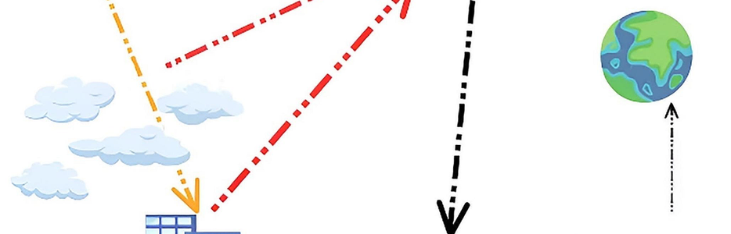
TERRAPULSE × GOLD FIELDS GHANA / 2026
07 / 12
FEATURE GROUP 03 — THE MAP
The map — where the evidence is read.
THE PROBLEM
THE POINT
Layers in five different viewers, none of them speaking to each other.
Every layer on one viewer — visible, faded, interrogated, traced.
Magnetics in a geophysics package, geochem in a spreadsheet pivot, geology in a PDF, licence boundary in a GIS project file. The geologist keeps four windows open and a mental map of how they align. By the time the question is asked, the alignment was in someone’s head.
MULTI-LAYER VIEWER — 5 BASEMAPS, LICENCE BOUNDARY ALWAYS DRAWN
01
Multi-layer viewer — 5 basemaps incl. satellite & 3D terrain; licence boundary always drawn.
02
Layer panel — visibility & opacity per layer; hover explanation of why each layer matters.
03
Click-to-inspect — WGS84 + local UTM, raster values, nearest sample & known deposit.
04
Anomaly display — geochem coloured by percentile class (background → weak → moderate → strong).
THE IMPACT
The geologist reads the evidence spatially — and the viewer can be traced back to the file that produced it.
THE MAP — 4 FEATURES, 1 VIEWER
07 / 12
Notes:
- Show the layer panel on the live build — visibility and opacity per layer, with hover explanation of why each layer matters.
- Demo click-to-inspect: returns WGS84 + local UTM, raster values, nearest sample, nearest known deposit.
- Percentile classes are computed per-element from the project’s own population — not fixed cut-offs.
- Licence boundary is always drawn, never an opt-in — regulators look for this first.
- The viewer traces back to the file (and its checksum) that produced each layer — the audit link back to Claim 03.

Slide 8
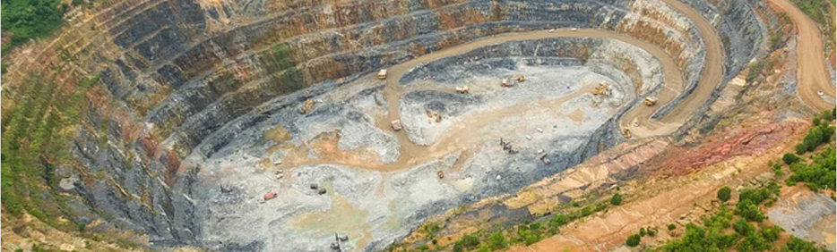
TERRAPULSE × GOLD FIELDS GHANA / 2026
08 / 12
FEATURE GROUP 04 — ANALYSIS & RANKED TARGETS
Ranked drill targets — the core of the platform.
THE PROBLEM
THE POINT
A target is a judgement — and judgements don’t survive turnover.
An expert-weighted deposit model over an assembled evidence grid.
On a Ghana licence, a senior geologist picks a drill collar location from experience: this magnetic low, this soil anomaly, this structural intersection. When they move on, the new geologist inherits a polygon, not a reasoning. The next drilling decision starts from a conclusion with no chain behind it.
PROSPECTIVITY SURFACE — SCORED GRID AS A MAP LAYER, RANKED TARGETS CLUSTERED ON TOP
01
Run analysis — one action over whatever evidence the project holds; progress reported live.
02
Evidence grid — per cell: magnetics, alteration, geochem anomaly, lithology, slope, road distance, deposit proximity, protected-area status.
03
Prospectivity scoring — orogenic-gold model with published weights; 0–100 per cell.
04
Ranked drill targets — highest cells clustered into distinct targets; rank, score, dual coords, depth-to-source.
05
Provenance panel — per target: datasets, checksums, processing steps, evidence contributions, model version.
THE IMPACT
A defensible drill target list — not a polygon someone has to vouch for from memory.
QP ANNOTATION — NOTES, REVIEW STATUS, REVIEWER NAME & DATE — PERSISTED INTO EVERY EXPORT
RANKED DRILL TARGETS — 7 FEATURES
08 / 12
Notes:
- Orogenic-gold weights are published (NOT proprietary) — the model is auditable, not a black box.
- Depth-to-source is derived from the RTP produced in Stage 03 of the pipeline (slide 06).
- QP notes — reviewer, status, date — carry into the shapefile export, which matters for Minerals Commission filings.
- Each target carries its evidence contribution breakdown, so a reviewer can see WHY it ranked, not just that it did.
- This is the deck’s centre of gravity — pause here; the next slide is the live map walkthrough.

Slide 9
TERRAPULSE × GOLD FIELDS GHANA / 2026
09 / 12
FEATURE GROUP 05 — EXPLORATION COPILOT (V2, 14 TOOLS)
An assistant that can only read your project — and has to cite what it used.
THE PROBLEM
THE POINT
A geologist's questions take days to answer — and the answers don't persist.
14 named tools. Every value resolved server-side. Every claim cited.
Grounded Q&A
Interpretation on request
"Why is target 03 ranked above target 05?" "What's the As anomaly threshold we used?" "Show me where the alteration signature is strongest." Today each of those is a half-day of re-opening projects, re-running queries, re-plotting. The answer lives in someone's head, then a slide, then nowhere.
Answers assembled from your project data, with citations.
Top-target reasoning, structural setting, data gaps.
Charts from live data
Map control from chat
Server-resolved values, never written by the model.
Show / hide a layer, the map view changes.
Reads your reports
Verified claims
Past conclusions answered from the document, not memory.
Deposit names checked against a known-deposits register before display.
Sessions & history
+ 7 MORE
Named conversations per project; earlier exchanges as context.
14 named tools total in the Copilot v2 spec.
THE MODEL SELECTS AND INTERPRETS. IT NEVER SUPPLIES VALUES. ANY UNVERIFIED DEPOSIT NAME IS STRIPPED BEFORE DISPLAY.
THE IMPACT
Designed so that it cannot invent a number — the geologist's question gets a defensible answer in seconds.
EXPLORATION COPILOT — 14 NAMED TOOLS, ZERO FABRICATION
09 / 12
Notes:
- The constraint is the feature: an LLM that cannot write a number is the only kind that belongs in disclosure.
- Name the verified-claims register — every deposit analogue is checked against a known-deposits list before it is shown.
- This is the ONLY AI in the deck — every other slide is deterministic.
- The model selects and interprets; the database supplies the values, server-side.
- Sessions are named per project, so earlier Q&A persists as context for the next question.

Slide 10
TERRAPULSE × GOLD FIELDS GHANA / 2026
10 / 12
FEATURE GROUP 06 — REPORTING & EXPORT (V2)
The deliverable — composed from the same data the map uses.
THE PROBLEM
THE POINT
The report and the screen never agree.
5 report types × 5 audience personas — versioned, not overwritten.
A report is written once, exported to PDF, circulated — and is out of date the moment a new assay lands. The map says one thing, the PDF on the regional VP's desk says another. Re-running the analysis doesn't update the report; it just creates another version that nobody reconciles.
REPORT TYPES
Technical Exploration
Executive Summary
Drill Program
Data QA
Comprehensive
AUDIENCE PERSONAS
Exploration Geologist
Qualified Person (NI 43-101 / JORC)
Investor
Project Manager
Environmental Officer
Versioned, not overwritten
Regenerating produces a new version; the old one is preserved.
Section lifecycle
Sections move draft → review → final; human edits are recorded.
Export formats
PDF for circulation; shapefile & KML for GIS / handhelds; CSV for coordinates & scores.
White-label
Consultants put their own logo, company name and contact on every document.
QP & INVESTOR VOICES ADDITIONALLY STRIP UNSUPPORTED CLAIMS
THE IMPACT
The document and the screen can never disagree — they are the same data, written twice.
REPORTING — 5 TYPES × 5 PERSONAS, VERSIONED
10 / 12
Notes:
- The QP voice is NI 43-101 / JORC aware — it strips unsupported claims automatically before circulation.
- White-label matters for consultants working alongside Gold Fields; the report carries their mark, not ours.
- The report IS the disclosure artefact — not a marketing piece.
- Versioned, not overwritten: regeneration produces a new version; the old one stays for audit.
- Same data, written twice — the screen and the PDF cannot disagree because they share one source.

Slide 11
TERRAPULSE × GOLD FIELDS GHANA / 2026
11 / 12
EVIDENCE & CONSTRAINTS
Where the data comes from — and the four constraints that make the output usable in disclosure.
Twelve sources, all licensed for commercial use, fetched to your boundary.
The argument that matters to a technical buyer.
Source | Provides | Role in scoring
Your survey data | Magnetics, geochem, assays | Primary anomaly evidence
Sentinel-2 | Iron oxide, clay/hydroxyl, vegetation | Alteration signature
Copernicus DEM | Slope, hillshade, drainage | Terrain & access
NOAA EMAG2 | Regional magnetic anomaly | Basement & structural context
Macrostrat | Lithology, age, structure | Host-rock favourability
OneGeology / BRGM | Geological map context | Interpretation backdrop
USGS MRDS | Known deposits & occurrences | Proximity weighting
WDPA | Conservation boundaries | Exclusion constraint
OpenStreetMap | Roads, settlements | Access & logistics scoring
Landsat / ASTER | Long-archive SWIR | Change detection, alteration
01
The model cannot write a number.
Every figure and statistic in Copilot & reports is resolved from the database server-side. The LLM selects and interprets; it never supplies values.
02
Ranking is withheld where the model does not apply.
The deposit model is tuned for orogenic gold. Other commodities get full data, maps and layers — but no ranked targets, rather than numbers from the wrong model.
03
Deposit names are verified before they are shown.
Any analogue cited in a generated summary is checked against a known-deposits register, and stripped if it does not match.
04
Nothing is a black box.
12 SOURCES TOTAL — rows above + your licence-boundary polygon & project metadata (commercial shape) = 12 integrated inputs.
Weights are published. Contributions are per-target. Processing parameters are recorded. Source files are checksummed.
EVIDENCE × CONSTRAINTS — THE TECHNICAL ARGUMENT
11 / 12
Notes:
- Constraint 02 is the deck's most important limit — gold-only ranking; copper, lithium, nickel get full data but no targets. Link forward to slide 12.
- Constraint 03 matters to a Birimian audience — analogues like Obuasi and Ahafo are checked against the register before they are surfaced.
- Constraint 01 — the LLM selects and interprets, but never supplies a value; everything resolves server-side.
- Constraint 04 — published weights, per-target contributions, checksummed source files; the audit trail is the product.
- All 12 sources are licensed for commercial use; no scraping, no grey data.

Slide 12
TERRAPULSE × GOLD FIELDS GHANA / 2026
12 / 12
WHAT IT DOESN'T DO YET — & NEXT STEP
Say these before they're found.
THE PROBLEM
THE POINT
Overselling reads as engineering judgement lost.
A Pilot plan engagement — sized for a real evaluation.
The fastest way to lose a senior geologist's trust is to let them discover a limit during the trial. So: the ranking is gold-only — copper, lithium, nickel get every layer, map and geochemical treatment, but no ranked targets. The weights are tuned for orogenic gold. Returning numbers from the wrong model would be worse than returning none.
10
15
SEATS
PROJECTS
150
60
RUNS / MO
REPORTS / MO
GOLD-ONLY RANKING — PER-COMMODITY PROFILES SPECIFIED, NOT YET BUILT
LICENCE BOUNDARY REQUIRED — NO POLYGON, NO ANALYSIS
INCLUDES
Map, upload, analysis, reports + Copilot + team
SMALLER GAPS — SOCIAL SIGN-IN, SELF-SERVICE PASSWORD, BRANDING ACCENT — VISIBLE BUT NOT FUNCTIONAL
Near-Pro capability, sized for a real evaluation rather than a trial. Heavy-AI work draws on usage credits — pay for what you use rather than being throttled. Top-ups via Paystack; visible ledger.
THE IMPACT — NEXT STEP
TERRAPULSE × GOLD FIELDS GHANA / AUG 2026 / ACCRA
Bring us one licence polygon on a Birimian ground. We'll return the ranked targets, the evidence attribution per target, and the provenance trail — and a senior geologist on your team decides whether the numbers are defensible.
END — SAY THESE BEFORE THEY'RE FOUND
12 / 12
Notes:
- Close on the single ask: one licence polygon on a Birimian ground — and we return ranked targets with the provenance trail.
- Reiterate the gold-only constraint as engineering judgement, not a gap — returning numbers from the wrong model would be worse than returning none.
- Thank the room and invite the senior geologist to challenge a specific number on any earlier slide.
- Pilot plan is sized for a real evaluation (10 seats, 15 projects, 150 runs/month, 60 reports/month) — not a free trial.
- Top-ups via Paystack with a visible ledger; pay for what you use rather than being throttled.

